Slide 1
Sharing selenium tips and tricks
Presenter: trang.ntt

Slide 2
Agenda
1
4
Improve find dynamic
element locator
Tools support
2
Improve find locator
by CSS vs Xpath
5
Access MS SQL
3
Compare structure of
CSS selector vs Xpath
6
Demo
Notes:
1> Tools support
2> Improve find locator by CSS selector
3> Improve find locator by Xpath
4> Compare structure of CSS selector vs Xpath 5> How to find dynamic element locator
6> Access MSSQL
7> Demo

Slide 3
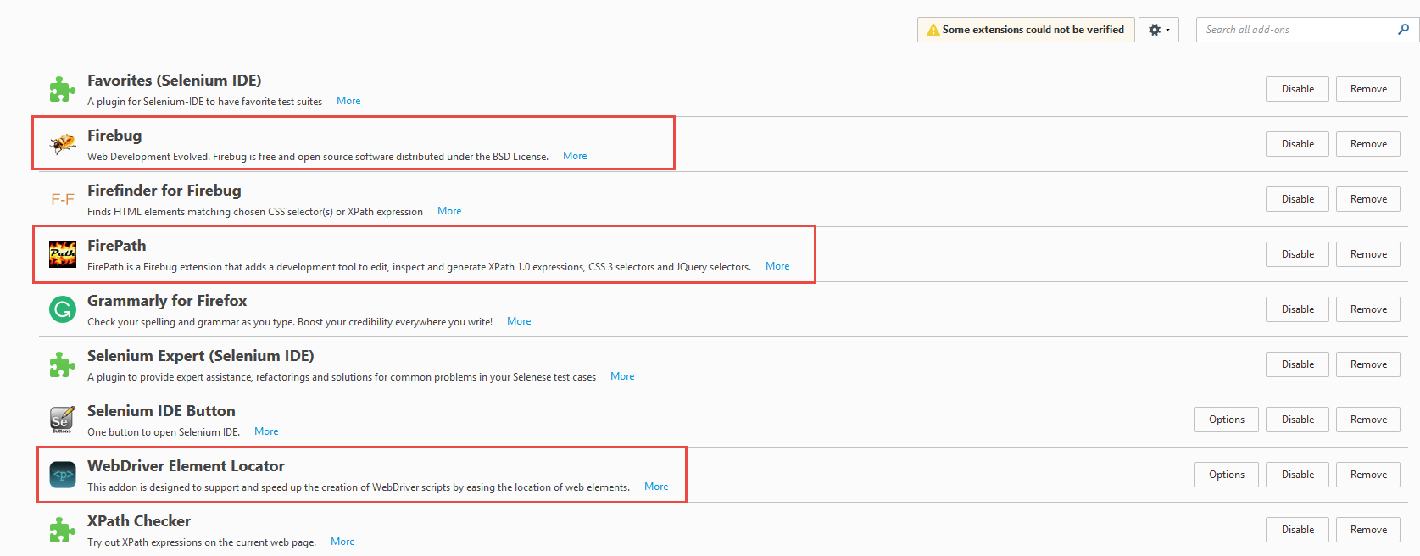
Tools support

Slide 4
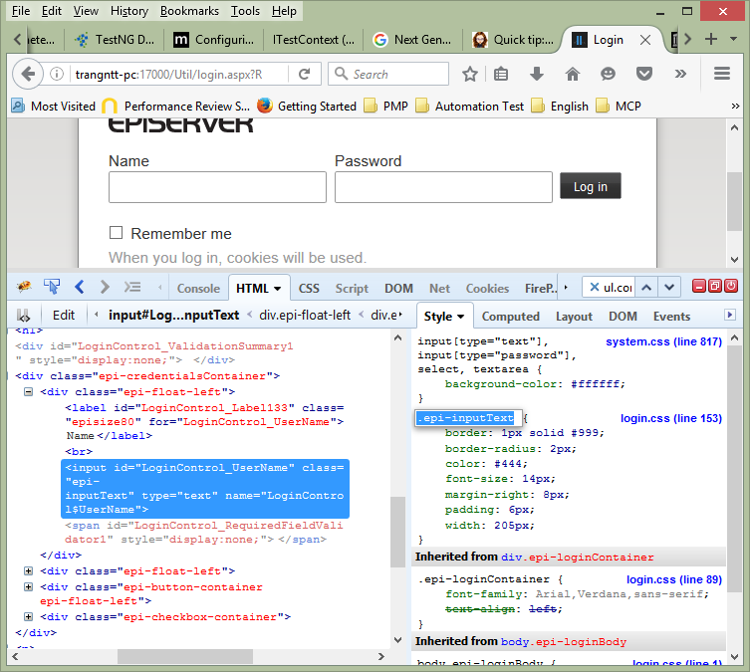
Improve find locator by CSS
In CSS, selectors are patterns used to select the element(s) you want to style.
Use our CSS Selector Tester to demonstrate the different selectors.
In Sauce Lab pages, they recommend using CSS as possible.
CSS Selector can locate the element faster than Xpath
http://sauceio.com/index.php/tag/selenium-tips/

Slide 5
Improve find locator by CSS
Selector | Description | Example | Css version
.class | .intro | Selects all elements with class="intro" | 1
#id | #firstname | Selects the element with id="firstname" | 1
* | * | Selects all elements | 2
element | p | Selects all <p> elements | 1
element,element | div, p | Selects all <div> elements and all <p> elements | 1
element element | div p | Selects all <p> elements inside <div> elements | 1
element>element | div > p | Selects all <p> elements where the parent is a <div> element | 2
element+element | div + p | Selects all <p> elements that are placed immediately after <div> elements | 2
element1~element2 | p ~ ul | Selects every <ul> element that are preceded by a <p> element | 3
[attribute] | [target] | Selects all elements with a target attribute | 2
[attribute=value] | [target=_blank] | Selects all elements with target="_blank" | 2
[attribute~=value] | [title~=flower] | Selects all elements with a title attribute containing the word "flower" | 2
[attribute|=value] | [lang|=en] | Selects all elements with a lang attribute value starting with "en" | 2
[attribute^=value] | a[href^="https"] | Selects every <a> element whose href attribute value begins with "https" | 3
[attribute$=value] | a[href$=".pdf"] | Selects every <a> element whose href attribute value ends with ".pdf" | 3
[attribute*=value] | a[href*="w3schools"] | Selects every <a> element whose href attribute value contains the substring "w3schools" | 3
:nth-last-of-type(n) | p:nth-last-of-type(2) | Selects every <p> element that is the second <p> element of its parent, counting from the last child | 3
:nth-of-type(n) | p:nth-of-type(2) | Selects every <p> element that is the second <p> element of its parent | 3
:nth-child(n) | p:nth-child(2) | Selects every <p> element that is the second child of its parent | 3
:nth-last-child(n) | p:nth-last-child(2) | Selects every <p> element that is the second child of its parent, counting from the last child | 3

Slide 6
Improve find locator by Xpath
XPath is the language used when locating XML (Extensible Markup Language) nodes. Since HTML can be thought of as an implementation of XML, we can also use XPath in locating HTML elements.
Advantage: It can access almost any element, even those without class, name, or id attributes.
Disadvantage: It is the most complicated method of identifying elements because of too many different rules and considerations.

Slide 7
Improve find locator by Xpath
Expression | Description | Path Expression | Result
Nodename | Selects all nodes with the name "nodename" | div | Selects all nodes with the name “div”
/ | Selects from the root node | /bookstore | Selects the root element bookstore Note: If the path starts with a slash ( / ) it always represents an absolute path to an element!
// | Selects nodes in the document from the current node that match the selection no matter where they are | bookstore/book | Selects all book elements that are children of bookstore
. | Selects the current node | //book | Selects all book elements no matter where they are in the document
.. | Selects the parent of the current node | bookstore//book | Selects all book elements that are descendant of the bookstore element, no matter where they are under the bookstore element
@ | Selects attributes | //@lang | Selects all attributes that are named lang
* | Matches any element node | /bookstore/* | Selects all the child element nodes of the bookstore element
@* | Matches any attribute node | //* | Selects all elements in the document
node() | Matches any node of any kind | //title[@*] | Selects all title elements which have at least one attribute of any kind

Slide 8
Compare structure of CSS vs Xpath
Reference:
http://www.w3schools.com/xsl/xpath_syntax.asp
http://www.w3schools.com/cssref/css_selectors.asp
https://www.simple-talk.com/dotnet/.net-framework/xpath,-css,-dom-and-selenium-the-rosetta-stone/
Demo:
http://swisnl.github.io/jQuery-contextMenu/demo.html
Css | Xpath
span.context-menu-one.btn.btn-neutral | //span[@class='context-menu-one btn btn-neutral']
ul.context-menu-list.context-menu-root>li:nth-child(1)>span Or ul.context-menu-list.context-menu-root>li>span:contains(‘Edit’) in CSS1, 2 | //ul[@class='context-menu-list context-menu-root']/li/span[contains(text(),'Edit')]

Slide 9
Improve find dynamic element
Find with relatively operator:
Start text:
Contains text:
Index: Determined the index in list element, then find the rules of generations
Related to closed stable element: span#uniqName_26_50>span.dijit.dijitReset.dijitInline.dijitToggleButton>span
If element has css class, use this locator
If element has name or id, use this locator
If none of the above is present, and you can not use linkText or another locator, go for xpath.

Slide 10
Access MS SQL
Step 1- Configuration connect SQL with JDBC:
https://www.microsoft.com/en-us/download/details.aspx?displaylang=en&id=11774
Step 2- Establishing a Connection:
Registries driver: Class.forName("com.microsoft.sqlserver.jdbc.SQLServerDriver");
Establish connection with the syntax follows:
jdbc:sqlserver://[serverName[\instanceName][:portNumber]][;property=value[;property=value]]
serverName: host name or IP address of the machine on which SQL server is running.
instanceName: name of the instance to connect to on serverName. The default instance is used if this parameter is not specified.
portNumber: port number of SQL server, default is 1433. If this parameter is missing, the default port is used.
property=value: specify one or more additional connection properties. To see the properties specific to SQL server, visit Setting the Connection Properties.

Slide 11
Access MS SQL
Step 3- Then Create a statement
Step 4- Then Execute your SQL query
Step 5- And Store the data in Result set
Step 6- Finally verify whether data (table) is updated or not
Lets implement the same using Java and DB as MS Access
Reference: http://www.codejava.net/java-se/jdbc/connect-to-microsoft-sql-server-via-jdbc

Slide 12
Demo

Slide 13
Q & A

